Slide 1
SCANSHARE FOR LEGAL

Slide 2
WORKFLOW AUTOMATION
Scanshare is a powerful, easy-to-use software solution that integrates paper and digital records into existing document management systems and repositories.
Capture and convert paper documents
Intelligent barcode detection
Smart page splitting
Zonal character recognition
Connector packs
Custom workflows and triggers
Multiple capture sources
Full workflow designer
Workflow triggering and variables
Notes:
The workflows are customizable, find something that fits your specific customers needs

Slide 3
LEGAL IN NUMBERS
1
Workers waste $20k annually in time with document challenges
2
Workers spend 18 minutes on average searching for a document
3
70% of businesses would fail within 3 weeks of a catastrophic loss of paper records
4
5.6 hours of billable work are missed every day by small law firms
446.5 million consumer records containing personally identifiable information (PII) were exposed last year
5

Slide 4
MARKET SUCCESS
Solo Law Firms
Boutique Law Firms
Full Service Firms
Multi-State Firms
Single Lawyer that handles general legal matters with one admin
A law firm with two-ten employees
Firms with several dozens of lawyers and employees, including lawyers, paralegals, admins, etc
Full-service firms covering multiple states with staff including lawyers, paralegals, admins, etc

Slide 5
WHERE WE WIN
Capture and Process Complex Data
Automate Workflows
Store and Access Client Information
Notes:
When you get the question, “what does this do for me”

Slide 6
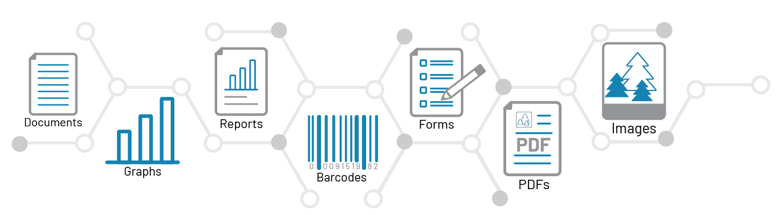
CAPTURE
Capturing data on court documents, contracts, invoices, and other paper documents takes time, effort, and is fraught with opportunities for human error.

Slide 7
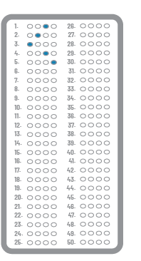
PROCESS
Processing features take multi-step, manual tasks to a new level of digitization. Features include:
Image Cleanup
Redaction + Annotation
Barcode Write + Read
Intelligent barcode detection
Smart page splitting
Zonal character recognition
Custom workflows and triggers
Smart OCR, Table Extraction, Zonal + Regex OCR
OMR
Data Lookup + Export
Intelligent Triggers + Routing
Notes:
With its high-powered optical character recognition (OCR), barcode reading and writing, deskewing, image converting, and Smart Invoicing, Scanshare Capture takes multi-step, manual tasks to a new level of digitization. The application offers intelligent barcode detection and smart page splitting that enables you to capture multiple pages but store each page separately. Zonal character recognition extracts specific information from the document by analyzing specific zones and using that information to route, rename, or store the document in a specific location.
As the application processes a document, custom workflow triggers are activated when processing conditions are met and dynamic decisions are made on the processing routes. For example, if a specific client name, matter number, or document type is detected, the system will trigger selected tasks such as filing the document in a specific CRM as an attachment or parsing the data into an accounting system. In any situation, you can create custom notifications and advanced scripting to allow for documents that require attention, review, or approval.
Scanshare’s Smart OCR module enables intelligent data capturing to optimize inefficient document workflows where the user still requires manual data entry.
No pre-classification required
Create patterns based on verticals
Match and validate the data with your database
Add data and error validation combining the Verification module

Slide 8
STORE + ACCESS CLIENT DATA
In addition to workflows, we can create custom file-type locations to avoid confusion among cases, lawyers, locations, etc. With integrated scanning capabilities, documents can be sent directly to Google Drive, Dropbox, OneDrive, or another location to ensure maximum security.

Slide 9
STORE
With more than 80 connectors in the Scanshare library, you can store your documents to almost endless locations, including:
Document management systems
ERP platforms
CRM applications
Cloud-based file storage platforms
Notes:
The last step in the advanced capture process is assuring that your digital data is stored in a place where it is accessible and useful for your organization. With more than 80 connectors in the Scanshare library, you can store your documents to almost endless locations, including our own file repository and many popular global document management systems, ERP platforms, CRM applications, and a host of cloud-based file storage platforms. With full integration to Active Directory and OAuth, accessing shared resources couldn’t be easier. Via their single sign-on, users only have access to the resources their network credentials or AD group permits, making it easier for system administrators.
With the flexibility of the platform, Scanshare can streamline existing processes filling the gap with the existing third-party systems.
Multiple capture sources
Full workflow designer
Workflow triggering and variables
Connector packs

Slide 10
PROSPECTING QUESTIONS
How do you currently manage documents in your legal practice? Do you use any software or tools for document processing and management?
Have you faced any challenges with organizing, storing, or retrieving documents in your legal practice? If so, how have you addressed these issues?
How do you ensure document security and compliance in your legal practice? What measures do you take to protect confidential information and meet regulatory requirements?
How do you currently handle document collaboration with your team and clients?

Slide 11
PROSPECTING QUESTIONS
What are the most important paper-based documents in your firm?
How many documents of this type are stored currently?
Can the document flow be digitized earlier to increase efficiency?
Can metadata be employed at the time of scanning to direct the document through the organization automatically?
Does the document require some type of restricted access, security, or encryption?
How do you access these documents on the go?

Slide 12
PROSPECTING QUESTIONS
Do you backup your paper-based information?
What would happen if you suffered a total loss of your paper documents?
How much does it cost (labor/time) to file a paper document?
How much does it cost (labor/time) to retrieve a paper document?
What percentage of business-critical data is stored just on paper?

Slide 13
WHY IMPLEMENT SCANSHARE?
Increased efficiency and productivity
Improved security
Compliance with regulations and industry standards
Cost savings
Improved organization and document classification
Notes:
Document management software allows staff members to quickly and easily search for and retrieve documents, leading to faster turnaround times and improved client satisfaction.
DMS software includes advanced security features such as encryption and user-level access controls to ensure that only authorized personnel can access sensitive documents, reducing the risk of data breaches and protecting the firm’s reputation.
Many software solutions come with built-in compliance features that can help a law firm meet regulatory requirements and industry standards, such as HIPAA and the GDPR, reducing the risk of legal penalties and fines.
Document management software can reduce printing and storage costs and decrease the need for additional staff members to handle document management tasks, saving the firm money on labor costs.
Document management software allows for easy organization and classification of documents by client or case, making it easy for staff members to find and access the documents they need. Additionally, it also allows for categorization of documents, this makes it easy to find specific documents and keep track of the document’s history. This feature helps in maintaining the structure and continuity of the document and reduces the chances of errors.

Slide 14
SCANSHARE DEMO
RAFAEL ADJUNTA

Slide 15
Fax
Scanner
Job Ticketing
Authentication
IT Team
Tracker

Slide 16
IT’S GAME TIME!
Did someone say prizes?

Slide 17
THANK YOU!
Follow us on social

